Slide 1
CyberSkills2Work The National Cybersecurity Workforce Development Program

Slide 2
Industrial Control Systems Security
Acknowledgement
This program is funded by the National Security Agency National Centers of Academic Excellence in Cybersecurity (NCAE-C) Program.
For additional information, please visit www.CyberSkills2Work.org.
Course Title
CRN
©2024 CyberSkills2Work - Institution Name

Slide 3

Threat Hunting
^{Module 07}
Notes:
Graphic generated by ChatGPT

Slide 4
Module 07 – ICS Threat Hunting
Overview
Define threat hunting and its importance in ICS environments
Identify common Indicators of Compromise (IOCs) associated with advanced threats targeting ICS systems
Discuss threat hunting strategies, potential threat actors, and their TTPs
Explain how to prioritize threat hunting activities based on risk and potential impact
Discuss threat hunting tools
Course Title
CRN
©2021 CyberSkills2Work - Institution Name

Slide 5
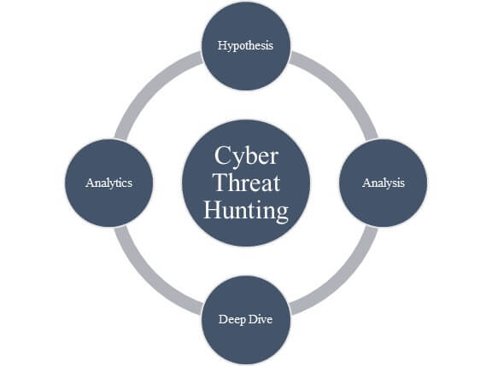
What is Threat Hunting?
Definition: Threat Hunting is a proactive cybersecurity practice aimed at detecting and isolating advanced threats that evade existing security solutions.
Proactive and Iterative
Knowledge-Driven
Goal-Oriented
Notes:
Threat Hunting is a proactive cybersecurity practice aimed at detecting and isolating advanced threats that evade existing security solutions. Unlike traditional security measures that rely on automated alerts and predefined rules, threat hunting involves a deliberate and iterative process where security teams actively search for, identify, and understand sophisticated cyber threats within an environment. This approach leverages deep knowledge of the network and its typical behavior to spot anomalies that suggest malicious activities.
Proactive and Iterative: Security teams continuously and systematically search for potential threats rather than waiting for automated systems to flag incidents.
Knowledge-Driven: Requires a deep understanding of the network, user behavior, and potential threat vectors to effectively spot and analyze anomalies.
Goal-Oriented: Focuses on detecting hidden threats and understanding their mechanisms to improve overall security posture and response strategies.
Graphic Source: https://hackforlab.com/cyber-threat-hunt-cycle/

Slide 6

Objectives of Threat Hunting in ICS
Proactively identify hidden threats
Minimize response time to incidents
Enhance the security posture
Increase understanding of the threat landscape
Ensure compliance with industry regulations
Develop a skilled security team
Notes:
Proactively Identify Hidden Threats
Detect threats that evade traditional security measures by actively searching for signs of compromise.
Minimize Response Time to Incidents
Reduce the time between the onset of an attack and its mitigation to minimize potential damage.
Enhance the Security Posture
Continuously improve defensive strategies based on the insights gained from hunting activities.
Increase Understanding of the Threat Landscape
Build a comprehensive understanding of potential attackers and their methods.
Ensure Compliance with Industry Regulations
Maintain adherence to industry-specific cybersecurity standards and regulations.
Develop a Skilled Security Team
Foster a culture of continuous learning and skill enhancement within the security team.
Graphic Source: https://fidelissecurity.com/use-case/threat-hunting/

Slide 7

Importance of Threat Hunting in ICS
Protecting Critical Infrastructure
Mitigating Advanced Persistent Threats (APTs)
Preventing Financial Losses
Compliance with Regulations
Safeguarding Against Emerging Threats
Enhancing System Resilience
Notes:
Protecting Critical Infrastructure
ICS systems are crucial for the operation of essential services like energy, water, and manufacturing. Threat hunting helps protect these systems from catastrophic failures that could result from cyber attacks.
Mitigating Advanced Persistent Threats (APTs)
ICS environments are often targets for APTs due to their strategic importance. Proactive threat hunting helps in identifying and mitigating these sophisticated attacks before they can cause significant damage.
Preventing Financial Losses
Cyber incidents in ICS can lead to enormous financial losses due to downtime, data breaches, and repair costs. Effective threat hunting reduces the likelihood of these expensive incidents.
Compliance with Regulations
Many industries with ICS are governed by strict regulatory requirements for cybersecurity. Threat hunting ensures compliance and avoids potential fines and legal issues
Safeguarding Against Emerging Threats
As cyber threats evolve, so must defense strategies. Threat hunting provides the agility to adapt to new threats as they emerge.
Enhancing System Resilience
Regular threat hunting activities strengthen the overall resilience of ICS against cyber threats, ensuring system robustness and reliability.
Graphic Source: https://www.electronicdesign.com/markets/automation/article/21254874/electronic-design-flexible-analog-ics-to-drive-software-defined-factories

Slide 8

Challenges: Threat Hunting in ICS
Complexity of industrial networks
Limited visibility
Integration of IT and OT
Resource constraints
Regulatory and Compliance Issues
Evolving threat landscape
Notes:
Complexity of Industrial Networks
ICS environments often consist of a mix of old and new technologies, proprietary systems, and complex network architectures that are difficult to monitor comprehensively.
Limited Visibility
Many ICS networks are not designed with cybersecurity in mind, resulting in limited visibility into network activities and making it hard to detect anomalies.
Integration of IT and OT
The convergence of information technology (IT) and operational technology (OT) creates unique security challenges, as IT security tools and practices may not be directly applicable to OT environments.
Resource Constraints
Many organizations face challenges in terms of budget, skilled personnel, and technological resources, which can hinder the implementation of effective threat hunting programs.
Regulatory and Compliance Issues
Navigating the complex landscape of industry regulations and compliance requirements can be a challenge, especially when these regulations are constantly evolving.
Evolving Threat Landscape
Cyber threats are continuously evolving, requiring threat hunting teams to constantly update their skills and tools to keep up with new tactics and techniques used by attackers.
Graphic Source: https://blogs.opentext.com/top-three-challenges-of-threat-hunting/

Slide 9

Identifying IOCs in ICS

Slide 10

What are IOCs?
Definition: Indicators of Compromise (IOCs) are pieces of forensic data that identify potentially malicious activity on a system or network.
Unusual Outbound Network Traffic
Geographical Irregularities
Anomalies in Privileged User Activity
Integrity of Files and Databases
Security Software Tampering
Unusual DNS Requests
Notes:
Indicators of Compromise (IOCs) are pieces of forensic data that identify potentially malicious activity on a system or network. They serve as crucial warning signs of security breaches, indicating that a system may have been compromised.
Unusual Outbound Network Traffic: Highlight this as an indicator of potential data exfiltration.
Geographical Irregularities: Access requests from unusual locations that do not align with the user’s normal patterns.Anomalies in
Privileged User Activity: Such as unauthorized access attempts or unusual operations performed.
Integrity of Files and Databases: Unauthorized modifications or deletions that could indicate data tampering.
Security Software Tampering: Including the disabling or altering of antivirus and security monitoring tools.
Unusual DNS Requests: Requests for domains that are uncommon or associated with known malicious sites.

Slide 11


Types of IOCs in ICS
Network Indicators
Spikes in data usage
Unexpected external communications
Traffic to known malicious IP addresses
Host Indicators
Unauthorized configuration changes
Unrecognized files or software
Log entries that suggest unauthorized access
Notes:
Network Indicators
These IOCs relate to network traffic and can include unusual activity such as spikes in data usage, unexpected external communications, or traffic to known malicious IP addresses.
Host Indicators
These involve changes or anomalies found on individual devices, such as unauthorized configuration changes, the presence of unrecognized files or software, or log entries that suggest unauthorized access.

Slide 12

Types of IOCs in ICS (cont’d)
Artifact Indicators
Malware files / Scripts
Toolkits
Backdoor installations
Behavioral Indicators
Repeated login attempts
Bypassing normal authentication processes
Systematically accessing confidential data
Notes:
Artifact Indicators
These are physical or digital pieces of evidence left by attackers, such as malware files, toolkits, backdoor installations, or scripts used to execute a breach.
Behavioral Indicators
Patterns of behavior that suggest malicious intent, like repeated login attempts from a single user account, bypassing normal authentication processes, or systematically accessing confidential data.

Slide 13

Sources of IOCs
System and Network Logs
Endpoint Detection and Response (EDR) Systems
Threat Intelligence Feeds
Employee Reports
Notes:
Internal Monitoring Tools
IOCs can be detected through internal systems such as Security Information and Event Management (SIEM) systems, intrusion detection systems (IDS), and antivirus software. These tools monitor network and system activity to identify anomalies that could indicate a compromise.
System and Network Logs
Logs provide a historical record of all system and network activities. Analyzing these logs can reveal suspicious patterns that may not trigger automated alerts but are indicative of compromise.
Visual: Endpoint Detection and Response (EDR) Systems
EDR systems provide detailed insights into endpoint activities, capturing data that can be analyzed to detect early signs of a breach.
Threat Intelligence Feeds
External threat intelligence sources provide information on new and emerging threats, including details about IOCs associated with specific threat actors, campaigns, or malware families.
Employee Reports
Employees can often detect anomalies in their daily operations, making them a valuable source of information for identifying potential security incidents.
Image Source: https://618media.com/en/blog/log-file-analysis-search-crawling/

Slide 14
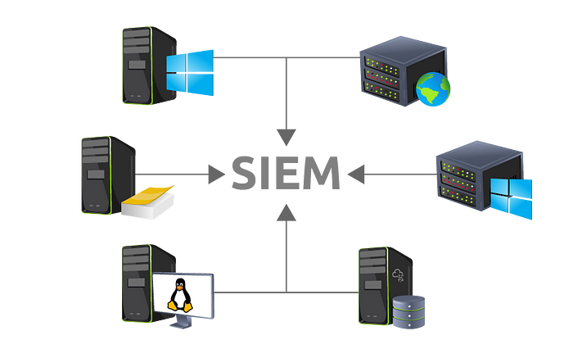
Tools for Identifying IOCs
Security Information and Event Management (SIEM) Systems
Intrusion Detection Systems (IDS)
Antivirus Software
Network Traffic Analysis Tools
Endpoint Detection & Response (EDR)
Forensic Analysis Tools
Notes:
Security Information and Event Management (SIEM) Systems
SIEM systems collect and aggregate log data from various sources within the ICS network, analyze this data in real time, and use correlation rules to identify potential security incidents.
Intrusion Detection Systems (IDS)
IDS are deployed to monitor network traffic for suspicious activity and known threats, generating alerts when potential security breaches are detected.
Antivirus and Antimalware Software
These tools are crucial for scanning systems and networks for known malicious signatures, helping to identify compromised nodes within the ICS environment.
Network Traffic Analysis Tools
These tools analyze network data packets to detect unusual patterns that may indicate the presence of malicious actors or malware.
Endpoint Detection and Response (EDR)
EDR tools monitor endpoint and server behaviors, logging detailed system activities and potentially malicious actions.
Forensic Analysis Tools
These tools are used after a potential security incident has been identified to perform deep dives into the digital footprints left by attackers.
Image Source: https://medium.com/@pr0f_41bu5/tryhackme-introduction-to-siem-writeup-df505bd2d1a0

Slide 15
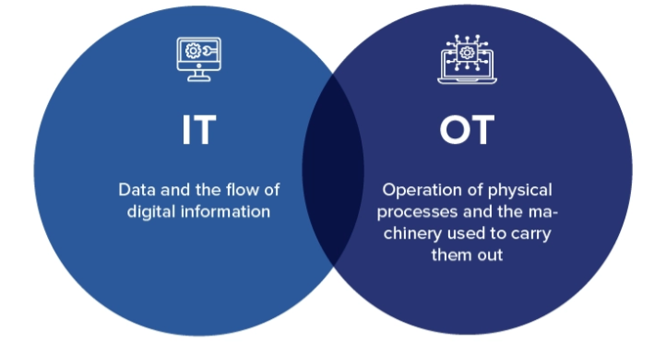
Challenges Identifying IOCs in ICS
High Volume of Data
Complexity of ICS Environments
Integration of IT and OT
False Positives and Alert Fatigue
Evolving Threat Landscape
Skill and Resource Constraints
Notes:
High Volume of Data
The sheer amount of data generated by ICS networks can make it difficult to identify meaningful security events without being overwhelmed by noise.
Complexity of ICS Environments
The heterogeneous nature of ICS, which often includes a mix of old and new technology, adds complexity to monitoring and managing security.
Integration of IT and OT
The convergence of information technology (IT) and operational technology (OT) creates unique security challenges, as IT-based security solutions may not be fully compatible with OT systems.
False Positives and Alert Fatigue
High rates of false positives can lead to alert fatigue, where critical alerts may be overlooked or dismissed as routine.
Evolving Threat Landscape
Cyber threats are continually evolving, making it challenging to keep threat detection capabilities up to date and effective against the latest attack vectors.
Skill and Resource Constraints
Limited availability of skilled cybersecurity professionals familiar with ICS, coupled with budget constraints, can hinder the effectiveness of IOC detection programs.
Image Source: https://appinventiv.com/blog/it-ot-convergence/

Slide 16

Best Practices: Effective IOC Detection
Regular Updates and Patch Management
Comprehensive Monitoring
Enhanced Data Analytics
Cross-Departmental Collaboration
Regular Training and Awareness Programs
Leverage Threat Intelligence
Simulations and Drills
Notes:
Regular Updates and Patch Management
Keeping all software and hardware up-to-date with the latest security patches is crucial to prevent exploitation of known vulnerabilities.
Comprehensive Monitoring
Implement a holistic monitoring strategy that includes all layers of the ICS environment, from physical access points to network traffic and endpoint systems.
Enhanced Data Analytics
Use advanced data analytics tools to sift through large volumes of data and identify patterns that may indicate a compromise.
Cross-Departmental Collaboration
Foster collaboration between IT and OT departments to ensure that security measures address the nuances of both technology areas effectively.
Regular Training and Awareness Programs
Regular training for all employees, focusing on security best practices and awareness of the latest cyber threats, to empower them to recognize signs of potential breaches.
Leverage Threat Intelligence
Utilize threat intelligence services to stay informed about the latest threat vectors and associated IOCs which can be integrated into the security monitoring tools.
Simulations and Drills
Conduct regular security drills and simulations to test the effectiveness of existing security setups and to identify gaps in the response strategy.
Image Source: https://saturnpartners.com/2024/04/building-a-robust-cybersecurity-awareness-program-to-empower-your-workforce/

Slide 17

Developing Threat Hunting Strategies

Slide 18
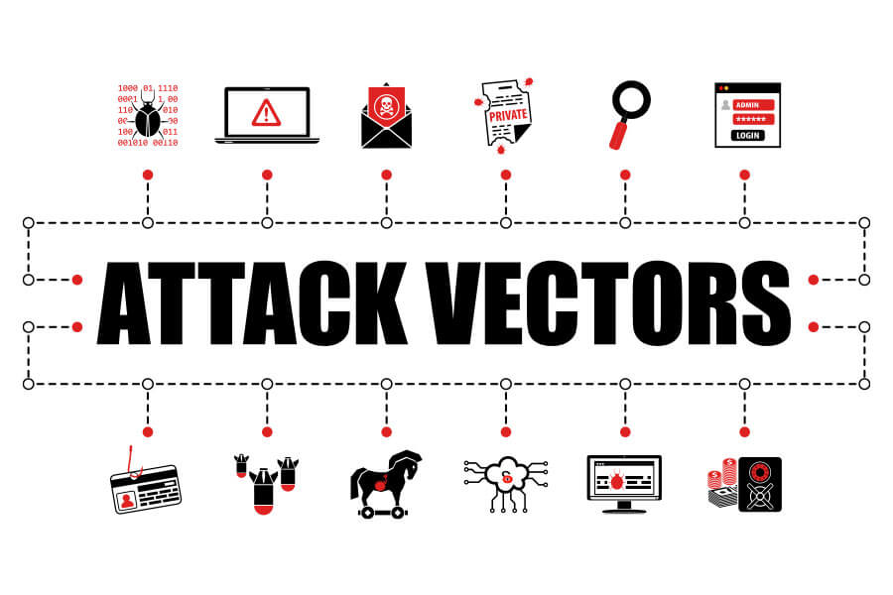
Understanding the Threat Landscape
Common Threat Actors
Nation-State Actors
Criminal Groups
Insiders
Hacktivists
Prevalent Attack Types in ICS
Ransomware
Advanced Persistent Threats (APTs)
Insider Threats
Notes:
COMMON THREAT ACTORS
Nation-State Actors: Interested in sabotage or espionage, often targeting critical infrastructure for political or military advantages.
Criminal Groups: Primarily motivated by financial gain, may engage in ransomware attacks or data theft.
Insiders: Employees or contractors who might intentionally or unintentionally compromise systems.
Hacktivists: Motivated to further social or political ends.
PREVALENT ATTACK TYPES IN ICS
Ransomware: Disrupts operations by encrypting critical data and demanding ransom
.
Advanced Persistent Threats (APTs): Long-term targeted attacks aiming to steal information or disrupt operations.
Insider Threats: Actions by individuals within the organization that lead to breaches or system manipulations.
Image Source: https://www.itispivotal.com/post/common-attack-vectors
Image Source: https://www.linkedin.com/pulse/threat-actors-who-why-should-we-care-joe-clarke-cism-/

Slide 19
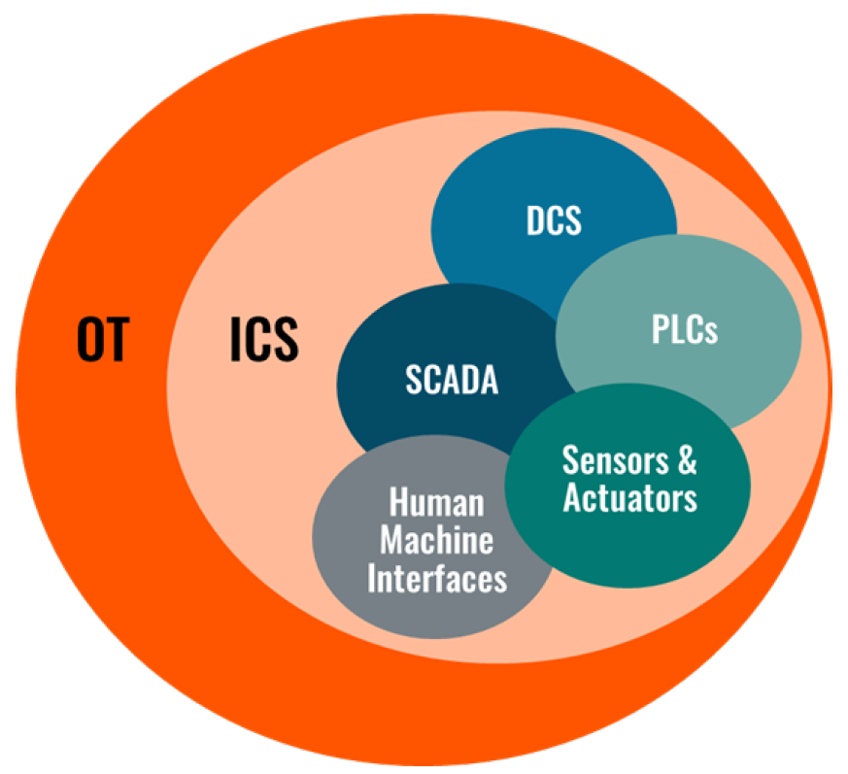
Identifying Key Assets in ICS
Criteria for Determining Key Assets
Impact on Safety
Operational Necessity
Regulatory Compliance
Economic Impact
Techniques for Asset Identification
Network Mapping
Vulnerability Assessments
Historical Data Analysis
Notes:
CRITERIA FOR DETERMINING KEY ASSETS
Impact on Safety: Assets whose compromise could pose risks to human life or health.
Operational Necessity: Systems essential for day-to-day operations.
Regulatory Compliance: Components that are critical for meeting legal and regulatory requirements.
Economic Impact: Assets whose disruption would result in significant financial loss.
TECHNIQUES FOR ASSET IDENTIFICATION
Network Mapping: Utilize tools and software to create a comprehensive map of all networked assets.
Vulnerability Assessments: Conduct assessments to identify vulnerabilities that could be exploited in a cyber attack.
Historical Data Analysis: Review past incidents and logs to determine which systems have been targeted or could be at risk.
Image Source: https://cdn2.abiresearch.com/static/ck_image/2023/03/28/image-20230328082230-1.png

Slide 20

Case Study: Oldsmar Water Treatment Facility
Notes:
Background: In February 2021, an unauthorized intruder accessed the computer systems of a water treatment plant in Oldsmar, Florida. The intruder attempted to poison the water supply by increasing the levels of sodium hydroxide (lye) to dangerous levels. Sodium hydroxide is typically used in small amounts to control the acidity of water and remove metals before distribution to the public.

Slide 21

Case Study: Key Events
Exploited remote access software
Intruder accessed the system
Attacker attempted to increase sodium hydroxide
Unusual activity identified by plant operator
Notes:
KEY EVENTS
The cyber attacker exploited remote access software that was used by the facility to allow authorized personnel to troubleshoot system problems remotely.
The intruder accessed the system, taking advantage of insufficient security measures and weak password policies.
The attacker attempted to increase the sodium hydroxide dosage from 100 parts per million to 11,100 parts per million.
Fortunately, a plant operator quickly noticed the unusual activity on the system and intervened to reverse the command, averting a potential public health disaster.
Image Source: https://www.industrialcybersecuritypulse.com/wp-content/uploads/2021/02/CFEx_WEB_IMG_WaterPicture.jpg

Slide 22

Case Study: Lessons Learned
Exploited remote access software
Intruder accessed the system
Attacker attempted to increase sodium hydroxide
Unusual activity identified by plant operator
Notes:
LESSONS LEARNED
Critical Asset Identification: This incident underscored the necessity of recognizing which systems have direct impacts on public safety and prioritizing their security.
Enhanced Security Measures: Following the incident, the facility reviewed and improved its cybersecurity measures, including updating software, enhancing password policies, and restricting remote access.
Regular Monitoring and Training: Continuous monitoring of system operations and regular training for operators were emphasized to ensure that any unauthorized interventions could be spotted and addressed promptly.
The incident highlighted the potential dangers of cyber attacks on public utilities and prompted nationwide reviews and improvements in cybersecurity practices across similar facilities.
Image Source: https://www.linkedin.com/pulse/lessons-learned-from-oldsmar-water-treatment-plant-hack/

Slide 23
Techniques for Establishing Baselines in ICS
Network traffic analysis - Monitor and record typical traffic patterns, bandwidth usage, and communication frequencies.
System performance metrics - Document normal ranges for system performance indicators like CPU usage, memory usage, and I/O operations.
User behavior analytics - Track typical user activities and access patterns to establish what is considered normal behavior.
Notes:
Network Traffic Analysis: Monitor and record typical traffic patterns, bandwidth usage, and communication frequencies.
System Performance Metrics: Document normal ranges for system performance indicators like CPU usage, memory usage, and I/O operations.
User Behavior Analytics: Track typical user activities and access patterns to establish what is considered normal behavior.
Image Source: (none)

Slide 24
Tools and Technologies Used
Security Information and Event Management (SIEM)
Splunk
IBM Qradar
LogRhythm
Network traffic analysis tools
Wireshark
SolarWinds Network Performance Monitor
Endpoint Detection and Response (EDR) Systems
CrowdStrike Falcon
SentinelOne
Carbon Black
Notes:
*Note: should be a review from 7.1 Intrusion Detection Slides
SIEM systems collect and aggregate logs from various sources within the ICS network, providing real-time analysis and historical data to establish normal operational baselines.
Benefits: Enables comprehensive visibility across the network, facilitating anomaly detection based on deviations from established norms.
Examples: Splunk, IBM QRadar, and LogRhythm are popular SIEM solutions that are widely used in various industries.
-------------------------------
Network Traffic Analysis tools monitor the flow of data across the network to identify standard patterns and flag anomalies that diverge from the baseline.
Benefits: Helps in identifying unusual network traffic that could indicate cyber threats, such as data exfiltration or unauthorized external communications.
Examples: Wireshark for packet analysis, SolarWinds Network Performance Monitor, and Plixer Scrutinizer provide detailed insights into network traffic behavior.
--------------------------
EDR tools continuously monitor and collect data from endpoints, providing detailed insights into file activities, process executions, and network connections.
Benefits: Essential for identifying suspicious behavior on individual devices that might not be evident through network-level monitoring alone.
Examples: CrowdStrike Falcon, SentinelOne, and Carbon Black provide robust endpoint monitoring and response capabilities.
Image Source: none

Slide 25
Tools and Technologies Used (cont’d)
Behavior Analytics Platforms
Exabeam
Aruba Introspect
Data Logging and Visualization
Elasticsearch
Logstash
ELK Stack
Automated Configuration and Change Management Tools
Chef
Puppet
Ansible
Notes:
Behavior Analytics Platforms use machine learning and AI to understand typical user and device behaviors and detect irregularities that could indicate security issues.
Benefits: Particularly effective in identifying insider threats or compromised credentials by noticing activities that deviate from the user’s normal behavior patterns.
Examples: Exabeam and Aruba Introspect utilize advanced analytics to profile and predict normal and anomalous behaviors.
--------------------------------------
Data Logging and Visualization Tools log and visualize operational data can help in setting and adjusting baselines by providing a clear view of system and user activities over time.
Benefits: Visualization helps in quickly spotting trends and outliers, making it easier to adjust baselines in response to changes in the operational environment.
Examples: Elasticsearch, Logstash, and Kibana (ELK Stack) and Grafana are widely used for logging and visualizing data.
------------------------------------
Automated Configuration and Change Management Tools monitor configurations and changes across network devices and systems to ensure that all alterations are recorded and evaluated against the baseline.
Benefits: Essential for maintaining the integrity of baseline settings and quickly identifying unauthorized changes.
Examples: Chef, Puppet, and Ansible provide automation and configuration management that can help maintain consistent settings and quickly revert unauthorized changes.
Image Source: (none)

Slide 26

Challenges and Benefits
Challenges
Complexity of ICS environments
Dynamic Nature of industrial processes
Benefits
Proactive Threat Detection
Enhanced Incident Response
Notes:
CHALLENGES
Complexity of ICS Environments: Highlight how the diversity and complexity of ICS can make it difficult to define a clear baseline.
Dynamic Nature of Industrial Processes: Point out that changes in production or operational processes can alter what is considered 'normal,' requiring continuous updates to the baseline.
BENEFITS
Proactive Threat Detection: Explain how a solid baseline allows for quicker identification of anomalies that may indicate a security incident.
Enhanced Incident Response: Discuss how understanding the normal state can speed up the response time by quickly pinpointing irregular activities.
Image Source: https://thumbor.forbes.com/thumbor/fit-in/1290x/https://www.forbes.com/advisor/wp-content/uploads/2022/11/Employee_Benefits_-_article_image.jpg

Slide 27

Implementing Proactive Hunting Techniques
Key Techniques for Threat Hunting
Behavioral Analysis
Endpoint Detection
Honeypots
Threat Intelligence Integration
Sandboxing
Building a Threat Hunting Team
Continuous Training & Skill Development
Automation and Machine Learning
Notes:
KEY TECHNIQUES:
Behavioral Analysis: Monitoring systems and networks for abnormal activities that deviate from the established baseline, which could indicate a compromise.
Endpoint Detection: Utilizing EDR tools to gather and analyze detailed data from endpoints to detect early signs of malicious activity.
Honeypots: Deploying decoy systems to attract attackers, which helps to identify and study their tactics and techniques without risking actual assets.
Threat Intelligence Integration: Leveraging external and internal threat intelligence to enhance detection capabilities by being informed of the latest attack vectors and indicators.
Sandboxing: Isolating suspicious files or programs in a secure environment to observe their behavior without risking the main network.
Building a Threat Hunting Team: discuss the importance of assembling a specialized team with diverse skills in cybersecurity, networking, and system administration to effectively conduct threat hunting operations.
Continuous Training and Skill Development: Emphasize the necessity for continuous learning and skill enhancement for the threat hunting team to keep pace with evolving cyber threats.
Automation and Machine Learning: Discuss how automation and machine learning can be integrated into threat hunting to enhance efficiency and effectiveness, allowing for the scaling of operations.
Image Source: https://www.appknox.com/blog/enhancing-mobile-app-security-through-sandboxing-isolation

Slide 28

Simulation and Continuous Improvement
Types of Simulations
Tabletop Exercises
Red Team Exercises
Feedback Loops
Continuous Improvement Process
Leveraging Technology for Simulations
Benefits of Regular Drills
Notes:
Types of Simulations
Tabletop Exercises: Discuss purpose and importance
Enhance the understanding of everyone’s role during an incident.
Identify gaps in response plans.
Improve interdepartmental cooperation and communication.
Validate and refine incident response (IR) plans and strategies.
Red Team Exercises: Discuss where a designated adversary team (Red Team) actively attempts to penetrate the defenses to test the response of the threat hunting team (Blue Team).
Feedback Loops
Discuss how feedback from simulations and real incident responses is vital for refining threat hunting tactics and strategies.
Continuous Improvement Process
Discuss how continuous improvement is integrated into threat hunting practices, involving regular updates to tools, tactics, and procedures based on the latest cybersecurity research and incident insights.
Leveraging Technology for Simulations
Discuss how advanced software and virtual environments can be used to create realistic simulations that help in training and evaluating the cybersecurity team.
Benefits of Regular Drills
Summarize the benefits such as improved readiness, better team coordination, faster reaction times, and ultimately a more resilient cybersecurity posture.
Image Source: https://cybergladius.com/creating-fun-cybersecurity-tabletop-exercises/

Slide 29
Collaboration and Communication in Threat Hunting
Importance of Collaboration
Challenges to Effective Collaboration
Strategies for Enhancing Communication
Role of Leadership
Training and Awareness Programs
Benefits of Collaborative Threat Hunting
Notes:
Importance of Collaboration
Stress the critical need for seamless collaboration between IT (Information Technology) and OT (Operational Technology) teams, as well as between the cybersecurity team and other departments such as operations, engineering, and executive management.
Challenges to Effective Collaboration
Discuss common barriers to effective collaboration, including siloed departments, differing priorities, and communication gaps.
Strategies for Enhancing Communication
Provide strategies for improving communication, such as regular cross-departmental meetings, integrated communication platforms, and shared goals and metrics.
Role of Leadership in Cybersecurity Collaboration
Highlight the role of organizational leadership in fostering a culture of security awareness and collaboration.
Training and Awareness Programs
Discuss the importance of regular training programs that are inclusive of all relevant stakeholders to ensure everyone understands their role in cybersecurity.
Benefits of Collaborative Threat Hunting
Discuss the benefits of collaborative threat hunting, such as more comprehensive threat coverage, faster incident response, and a unified approach to managing cybersecurity risks.
Image Source: none

Slide 30

Prioritizing Threat Hunting Activities in ICS
Notes:
Image Source: ChatGPT

Slide 31

Why Prioritize in Threat Hunting?
Resource Optimization
Enhanced Efficiency
Risk Management
Strategic Alignment
Regulatory Compliance
Notes:
Resource Optimization
In environments as complex and critical as ICS, resources—whether they are time, personnel, or financial—are often limited. Prioritizing threat hunting activities ensures that these resources are allocated where they can have the most significant impact on reducing risk and enhancing security
Enhanced Efficiency
Prioritization helps focus efforts on high-risk areas, which can lead to quicker detection and mitigation of threats. This focus is crucial in preventing potential attacks from escalating into serious incidents that could disrupt operations.
Risk Management
By prioritizing threat hunting activities based on the risk and criticality of assets, organizations can better manage their cybersecurity risks, focusing on protecting areas that could cause the most significant damage if compromised.
Strategic Alignment
Prioritization ensures that threat hunting aligns with the organization’s overall cybersecurity strategies and business objectives, supporting not just technical needs but also organizational resilience.
Regulatory Compliance
Many ICS environments are governed by stringent regulatory requirements that dictate certain security measures. Prioritizing areas that impact compliance can help avoid legal and financial penalties.
Image Source: https://www.tidalcyber.com/threat-hunting-prioritization

Slide 32

Criteria for Prioritizing Threat Hunting
Criticality of Assets
Vulnerability to Threats
Consequence of Breach
Exposure Level
Regulatory & Compliance Requirements
Previous Incident History
Notes:
Criticality of Assets
Prioritize assets based on their criticality to the organization’s operations. Key assets include those whose compromise could severely impact operational integrity, safety, or lead to significant financial losses.
Vulnerability to Threats
Consider the vulnerability of assets to various cyber threats. Assets that are more susceptible to attacks due to outdated systems, lack of security measures, or inherent weaknesses should be given higher priority.
Consequence of Breach
Discuss how you need to evaluate the potential consequences of a breach. Assets that could cause substantial harm to the organization, its stakeholders, or the public if compromised should be high on the priority list.
Exposure Level
Assets that are more exposed to potential attackers, such as those accessible via the internet or those in less secure physical locations, should be prioritized for threat hunting.
Regulatory and Compliance Requirements
Compliance with legal and regulatory requirements can also dictate prioritization. Assets that involve regulatory data protection standards (e.g., NERC CIP for energy, GDPR for data privacy) require heightened security measures.
Previous Incident History
Assets that have been targeted in past security incidents may warrant increased attention, as historical data can indicate potential future risks.
Image Source: https://railsware.com/blog/product-features-prioritization/

Slide 33

Tools and Techniques for Effective Threat Hunting Prioritization
Automated Risk Assessment Tools
Threat Intelligence Platforms
Security Analytics Tools
Incident Response Platforms
Collaborative Tools
Notes:
Automated Risk Assessment Tools
Discuss how automated tools can help streamline the risk assessment process by quickly identifying vulnerabilities and assessing risks based on predefined criteria. Examples: RiskLens, Tenable, Nessus, Rapid7
Key Features: Real-time risk monitoring, vulnerability scanning, and impact analysis capabilities.
Threat Intelligence Platforms
Explain the role of threat intelligence platforms in prioritizing threat hunting by providing up-to-date information on emerging threats and attack vectors.
Benefits: Enhanced situational awareness and proactive threat hunting based on current threat landscapes.
Security Analytics Tools
Discuss how security analytics tools utilize data from various sources within the ICS to identify patterns and anomalies that may indicate potential threats.
Examples: IBM QRadar, Splunk Enterprise Security, or LogRhythm.
Incident Response Platforms
Outline how incident response platforms can help manage and prioritize alerts, ensuring that the most critical are addressed first.
Examples: Palo Alto Networks Cortex or FireEye Helix
Collaborative Tools
Discuss the importance of collaboration tools in facilitating communication and coordination among the threat hunting team and other departments. Examples: Microsoft Teams or Slack channels dedicated to cybersecurity
Advantages: Real-time sharing of threat information and coordinated response strategies.
Image Source: https://www.cyberworld.com.hk/product/fireeye-helix/

Slide 34

Implementing a Prioritized Threat Hunting Strategy
Strategy Development
Action Plan Creation
Resource Allocation
Training and Readiness
Monitoring and Evaluation
Notes:
Strategy Development
Begin with the development of a threat hunting strategy that integrates the prioritization criteria established through risk assessments and threat analyses.
Key Components: Defining objectives, setting goals, determining scope based on prioritized assets and threats.
Action Plan Creation
Outline how to create a detailed action plan that specifies what actions to take, who is responsible, and the timeline for execution. This plan should align with the strategic priorities identified.
Resource Allocation
Discuss the allocation of resources, including personnel, technologies, and budget, in accordance with the priority of the threat hunting tasks.
Training and Readiness
Discuss the need for training and preparing the threat hunting team to effectively implement the strategy. This includes both technical skills and knowledge of the operational environment. The objective is to ensure all team members understand their roles and are competent in the tools and techniques they will use.
Monitoring and Evaluation
Explain how ongoing monitoring and evaluation are crucial to assess the effectiveness of the threat hunting strategy and make necessary adjustments.
Image Source: https://easy-peasy.ai/ai-image-generator/images/staff-briefing-illustration-diverse-team-icons

Slide 35

Introduction to Threat Hunting Tools
Notes:
Image Source: https://cybersecuritynews.com/threat-hunting-tools/

Slide 36
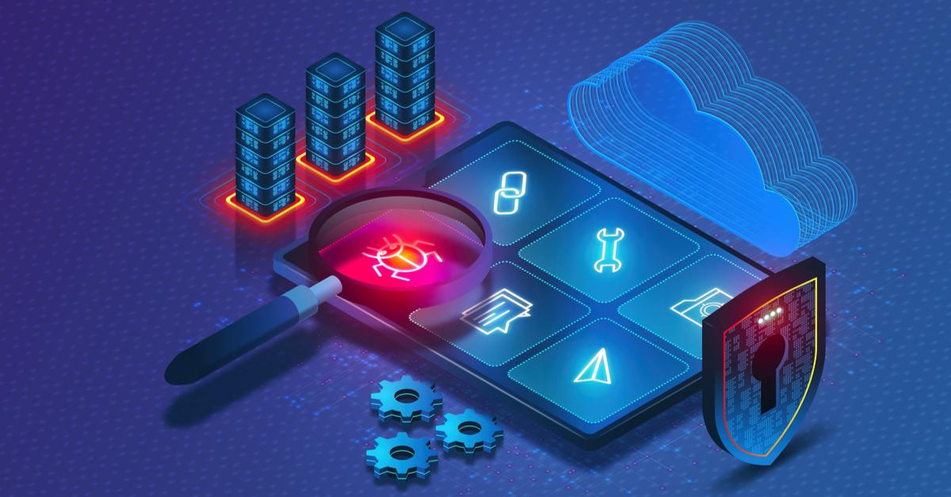
Understanding Threat Hunting Tools
Key Functions
Automated monitoring
Behavior analysis
Anomaly detection
Incident response
Benefits
Reduced detection time
Enhanced accuracy
Operational continuity
Compliance support
Notes:
Key Functions of Threat Hunting Tools
Automated Monitoring: Constant surveillance of the network and systems to quickly identify unusual patterns.
Behavior Analysis: Analysis of user and device behavior to detect deviations from normal operations.
Anomaly Detection: Using advanced algorithms and machine learning techniques to identify threats that traditional security measures may overlook.
Incident Response: Tools often include features that help coordinate and automate responses to identified threats, reducing the time between detection and response.
BENEFITS
Reduced Detection Time: Minimize the time it takes to detect threats, thereby reducing potential damage.
Enhanced Accuracy: Increase the accuracy of threat detection with sophisticated data analysis.
Operational Continuity: Maintain operational continuity by preventing or minimizing disruptions caused by cyber incidents.
Compliance Support: Help in maintaining compliance with industry-specific cybersecurity standards and regulations.
Image Source: https://www.sangfor.com/blog/cybersecurity/best-open-source-threat-hunting-tools

Slide 37
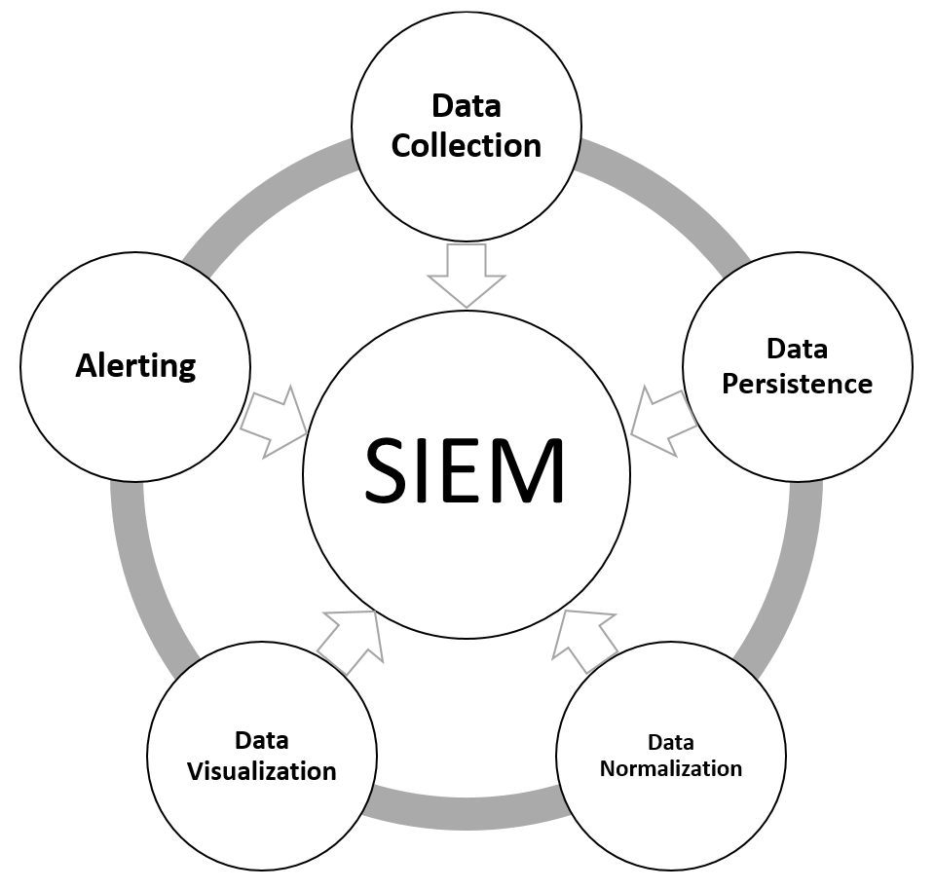
Categories of Threat Hunting Tools
Security Information and Event Management (SIEM)
Endpoint Detection and Response (EDR) Systems
Network Traffic Analysis Tools
Threat Intelligence Platforms
Deception Technology
Forensic Analysis Tools
Notes:
Security Information and Event Management (SIEM) Systems
SIEM systems aggregate and analyze log data from various sources within an ICS network, providing real-time analysis and alerts based on predefined rules and behaviors.
Benefits: Effective for identifying known threats and patterns, centralizing security monitoring, and managing incident response.
Endpoint Detection and Response (EDR) Systems
EDR solutions monitor endpoints for suspicious activities, capturing detailed data that can be used for forensic analysis and threat mitigation.
Benefits: Provides visibility into endpoint activities, crucial for detecting and responding to malware and other threats that bypass perimeter defenses.
Network Traffic Analysis Tools
These tools inspect the data passing through the network to identify unusual patterns or anomalies that might suggest malicious activity.
Benefits: Essential for spotting advanced threats that do not match known signatures or behaviors, offering a deeper insight into network operations
Threat Intelligence Platforms
Platforms that collect and analyze information about emerging or existing threat actors and their tactics, techniques, and procedures (TTPs).
Benefits: Enhances the ability of threat hunters to predict, identify, and respond to threats based on the latest intelligence.
Deception Technology
Tools that create decoys or traps within the network to lure attackers, revealing their presence and methods without exposing actual assets.
Benefits: Effective for identifying attackers who have penetrated network defenses, allowing for real-time threat analysis and response without risk to real assets.
Forensic Analysis Tools
Tools used to perform detailed investigations after a security incident has been detected, helping to understand the breach and prevent future occurrences.
Benefits: Critical for uncovering the root cause of incidents and ensuring comprehensive remediation measures are implemented.
Image Source: https://subscription.packtpub.com/book/data/9781788472173/11/ch11lvl1sec85/understanding-stream-processing

Slide 38
Integration of Threat Hunting Tools in ICS Environments
Compatibility Considerations
Protocols and Standards
System Impact
Seamless Integration Strategies
Pre-Deployment Testing
Phased Rollout
Operational Continuity (i.e. Real-Time Monitoring)
Data Privacy and Security (i.e. Access Controls)
Notes:
Compatibility Considerations
Discuss the importance of selecting tools that are compatible with the specific hardware and software environments of ICS, including legacy systems and proprietary protocols.
Protocols and Standards: Emphasize the need for tools that support common ICS protocols like Modbus, Profibus, and DNP3.
System Impact: Highlight tools designed to operate with minimal impact on system performance and reliability.
Seamless Integration Strategies
Outline strategies for integrating threat hunting tools into ICS networks seamlessly, ensuring they enhance security without interfering with operational integrity.
Pre-Deployment Testing: The importance of thorough testing in a controlled environment to ensure no adverse effects on operational systems.
Phased Rollout: Implementing tools in phases to monitor effects and make adjustments before wide-scale deployment.
Operational Continuity
Discuss the importance of maintaining operational continuity and how properly integrated threat hunting tools can assist in proactive maintenance and incident prevention.
Some other key points:
Real-Time Monitoring: Tools that provide real-time data can help identify potential operational issues before they cause system failures.
Incident Response: Enhanced capabilities to respond swiftly and effectively to any identified threats, minimizing downtime.
Data Privacy and Security
Address the considerations for ensuring that the integration of these tools adheres to data privacy and security regulations, particularly important in sectors with stringent compliance requirements.
Key points:
Data Handling and Storage: Ensuring that data collected by these tools is handled and stored securely, respecting privacy laws and compliance requirements.
Access Controls: Implementing strict access controls and logging to maintain security and traceability.
Image Source: none

Slide 39
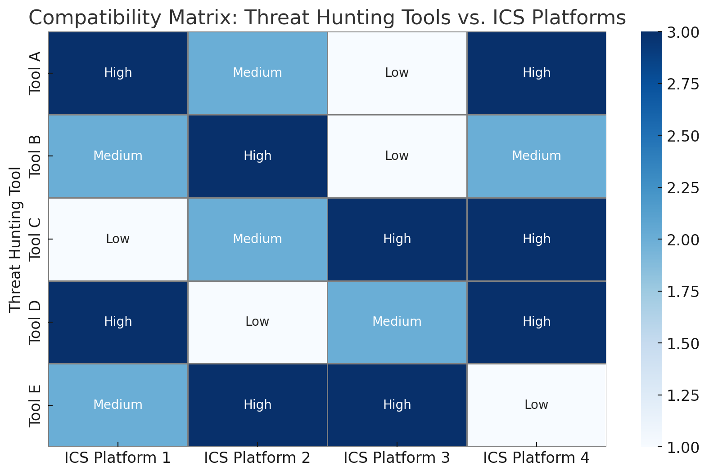
Choosing the Right Tools
Assessing Organizational Needs
Tool Compatibility and Integration
Evaluating Tool Effectiveness
Detection Rate
False Positives
User Interface
Vendor Reputation and Support
Regulatory Compliance
Notes:
Assessing Organizational Needs
Start off by emphasizing the importance of assessing the specific needs of the organization, including the nature of the ICS environment, the type of assets involved, and the predominant threat vectors.
Some key points:
System Complexity: Consider the complexity and diversity of the ICS architecture.
Risk Profile: Understand the organization's risk profile based on previous incidents and potential threats.
Tool Compatibility and Integration
Discuss the need for compatibility between threat hunting tools and existing ICS components, ensuring that tools can be seamlessly integrated without disrupting operational processes.
Key points:
Legacy Systems: Special considerations for integrating tools with older systems that are commonly found in ICS environments.
Scalability: Ensure tools can scale with the growth of the ICS and the evolving threat landscape.
Evaluating Tool Effectiveness
Outline criteria for evaluating the effectiveness of threat hunting tools, including detection capabilities, ease of use, and the ability to provide actionable insights.
Some key points:
Detection Rate: Accuracy and speed of threat detection.
False Positives: Rate of false alarms and the tool's impact on system operations.
User Interface: Usability and accessibility of the tool for ICS operators and cybersecurity teams.
Vendor Reputation and Support
Consider the reputation of the tool vendors and the level of support they offer, which can be crucial for ensuring the tool remains effective over time.
Key points:
Vendor Stability: Longevity and market presence of the vendor.
Customer Service: Availability and quality of technical support and training services.
Community and Updates: Regular updates and an active user community that can provide peer support.
Regulatory Compliance
Highlight the importance of selecting tools that help comply with industry regulations and standards, which is especially critical in highly regulated sectors like energy and water treatment.
Key points:
Data Protection: Tools must adhere to data privacy laws applicable to the organization.
Audit Capabilities: Features that facilitate compliance auditing and reporting.
Image Source: ChatGPT “can you draw a Compatibility matrix showing different threat hunting tools and their integration levels with various ICS platforms.”

Slide 40
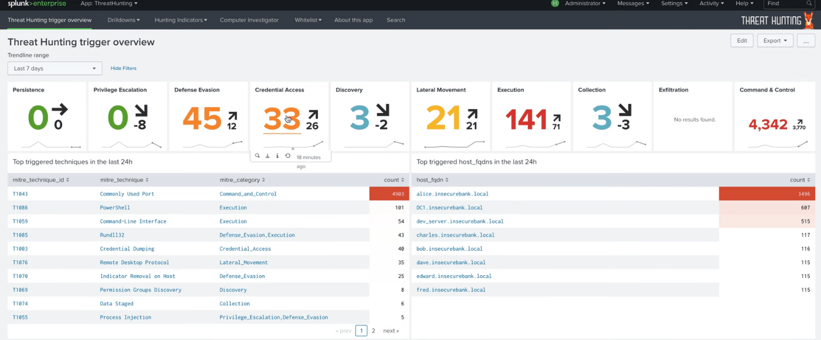
SIEM Systems
Notes:
Explain that SIEM systems collect, store, and analyze security data from various sources within an organization to provide real-time analysis and alerting of potential security threats.
Some Core Functions: Log aggregation, event correlation, alerting, dashboards, and compliance reporting.
Image Source: https://securityaffairs.com/81288/security/hunting-mitres-attck-splunk.html

Slide 41
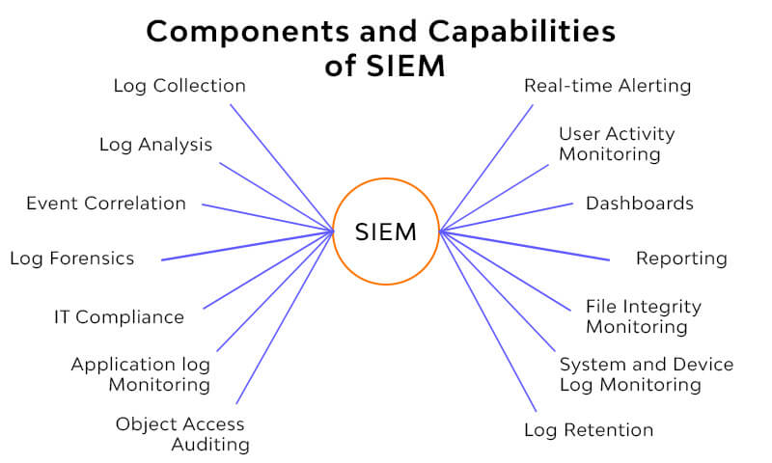
Capabilities of SIEM Systems
Real-time Monitoring and Alerts
Event Correlation
Forensic Analysis
Notes:
Real-time Monitoring and Alerts: Highlight the ability of SIEM to monitor data in real-time and generate alerts on suspicious activities.
Event Correlation: Explain how SIEM can correlate events across multiple sources to detect patterns that may indicate a cyber threat.
Forensic Analysis: Detail the tools available within SIEM systems for conducting forensic investigations into past security incidents.
Image Source: https://nordcloud.com/tech-community/advantages-of-siem/

Slide 42

Popular SIEM Tools
Splunk Enterprise Security
IBM QRadar
ArcSight (by Micro Focus)
LogRhythm
Siemplify (now part of Google Cloud)
Notes:
Splunk Enterprise Security: Splunk is renowned for its powerful data ingestion and analytics capabilities. It can integrate data from IT and OT sources, providing comprehensive visibility across diverse systems. Splunk’s advanced analytics help detect, investigate, and respond to internal and external threats in real time.
IBM QRadar: QRadar is well-regarded for its advanced threat detection and compliance features. It supports a wide range of ICS and SCADA systems, making it ideal for environments with complex security requirements. Its ability to correlate data from various sources helps in identifying potential threats more accurately.
ArcSight by Micro Focus: ArcSight offers robust SIEM capabilities with a focus on real-time threat detection. Its flexible architecture can scale to suit various ICS environments, and it provides efficient tools for logging management, event correlation, and compliance reporting.
LogRhythm: LogRhythm combines SIEM, log management, network monitoring, and endpoint detection into a unified solution. It's particularly effective in environments where rapid detection and response are critical. LogRhythm also offers features tailored for critical infrastructure protection.
Siemplify: Known for its security orchestration, automation, and response (SOAR) capabilities, Siemplify can be integrated with existing SIEM systems to enhance their operational efficiency and streamline threat response processes.
Image Source: https://www.wizbrand.com/tutorials/how-can-we-become-splunk-enterprise-certified-admin/

Slide 43

Leveraging SIEM for Threat Hunting in ICS
Integration Across IT and OT
Customization of Rules and Alerts
Continuous Updating of Threat Intelligence
Automated Response Capabilities
Regular Training and Drills
Forensic Capabilities
Notes:
Integration Across IT and OT: Ensure the SIEM solution can integrate data from both IT and OT sources. This integration is crucial for providing a holistic view of the cybersecurity landscape and for early detection of anomalies that could indicate complex cyber threats.
Customization of Rules and Alerts: Tailor the rules and alerts within the SIEM system to reflect the specific operational and security requirements of your ICS environment. Customization helps reduce noise, minimizing false positives, and focusing on the most relevant threats.
Continuous Updating of Threat Intelligence: Regularly update your SIEM system with the latest threat intelligence. This practice helps the system stay abreast of emerging threats and techniques used by attackers, enhancing its effectiveness in threat detection and response.
Automated Response Capabilities: Utilize the automated response features of SIEM tools to accelerate the mitigation process once a threat is detected. Automation helps contain and control damage, particularly crucial in ICS environments where response time is critical.
Regular Training and Drills: Conduct regular training sessions and simulation drills for your security team. These exercises help ensure that team members are proficient in using the SIEM tools and can respond effectively under different threat scenarios.
Forensic Capabilities: Leverage the forensic analysis features of your SIEM system to investigate breaches after they occur. Understanding how a breach happened and the pathway attackers took can provide critical insights for strengthening your security posture.
Image Source: https://splunkdoctor.com.au/security-operations-centre-with-splunk-enterprise-security/

Slide 44

Network Traffic Analysis Tools
Notes:
Explain that Network Traffic Analysis tools are used to inspect, categorize, and analyze network traffic to detect and respond to anomalies that could indicate security threats.
Highlight the importance of these tools in identifying unusual patterns that might escape other forms of detection.
Image Source: https://ai-techpark.com/importance-of-network-traffic-analysis/

Slide 45
Capabilities of Network Traffic Analysis Tools
Deep Packet Inspection - ability to examine the content of packets, not just the header data, for detailed analysis.
Behavioral Analytics - use of advanced algorithms to establish baseline behaviors and identify deviations.
Encrypted Analysis - Techniques to analyze encrypted data flows without decryption, respecting privacy while maintaining security.
Notes:
Deep Packet Inspection: Ability to examine the content of packets, not just the header data, for detailed analysis.
Behavioral Analytics: Use of advanced algorithms to establish baseline behaviors and identify deviations.
Encrypted Traffic Analysis: Techniques to analyze encrypted data flows without decryption, respecting privacy while maintaining security.
Image Source: none

Slide 46
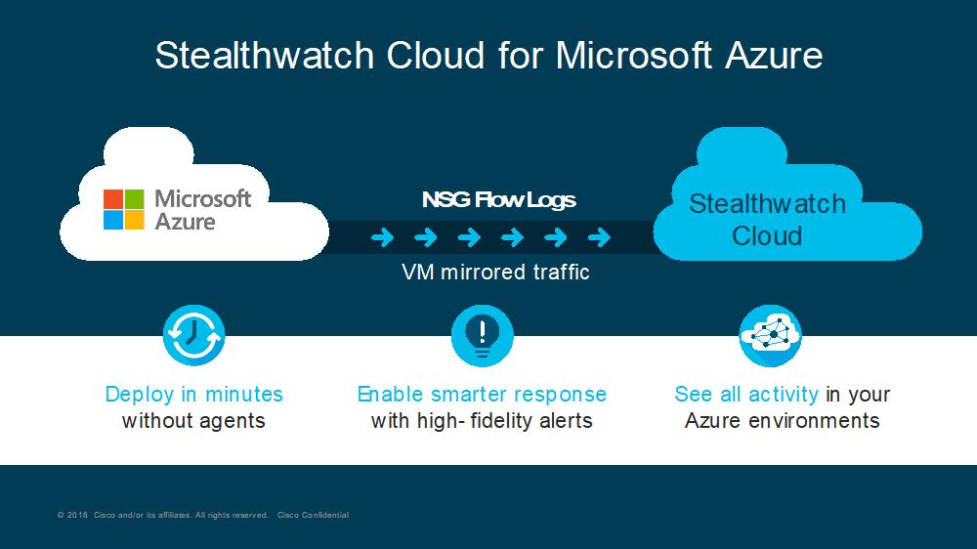
Popular Network Traffic Analysis Tools in ICS Environments
Darktrace Industrial
Claroty Continuous Threat Detection
Nozomi Networks Guardian
Cisco Stealthwatch
Tripwire Industrial Visibility
Notes:
Darktrace Industrial
Known for using artificial intelligence to detect and respond to threats across IT and OT environments. Darktrace Industrial can learn normal network behavior and detect anomalies indicative of cyber threats or operational issues.
AI-driven threat detection, real-time alerts, and visualization of network activities.
Claroty Continuous Threat Detection
Specifically designed for OT environments, Claroty provides deep visibility into industrial networks, helping to secure ICS from both cyber threats and operational errors.
Features: Comprehensive network monitoring, vulnerability assessments, and secure remote access management.
Nozomi Networks Guardian
Offers real-time visibility and security monitoring for industrial control networks. Nozomi Networks Guardian supports threat detection, asset inventory, and vulnerability assessment.
Features: Advanced machine learning capabilities, network visualization, and integration with existing security tools.
Cisco Stealthwatch
Provides enterprise-wide visibility and security analytics across the entire network, using telemetry data from existing infrastructure. It’s effective in both IT and OT environments.
Features: Encrypted traffic analysis, anomaly detection, and response management.
Tripwire Industrial Visibility
Tailored for industrial environments, Tripwire helps secure OT assets with deep packet inspection and threat detection capabilities.
Features: Asset discovery, threat modeling, and integration with change management processes.
Image Source: https://blogs.cisco.com/security/cisco-stealthwatch-cloud-and-microsoft-azure-reliable-cloud-infrastructure-meets-comprehensive-cloud-security

Slide 47
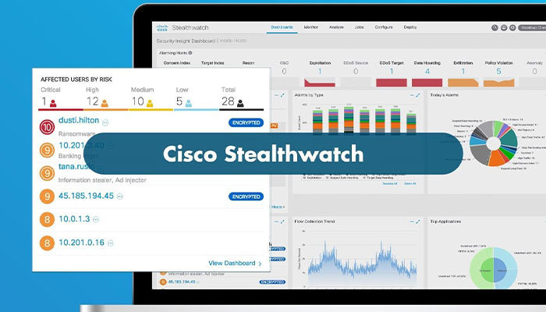
Leveraging Network Traffic Analysis for Threat Hunting in ICS
Comprehensive Network Mapping
Baseline Network Behavior
Integrate with Other Security Tools
Real-Time Alerting and Automated Response
Regularly Update and Tune
Training and Drills
Notes:
Comprehensive Network Mapping
Goal: Ensure that the Network Traffic Analysis (NTA) tool has visibility into all parts of your network. Start with a comprehensive mapping of your network to understand where to deploy NTA sensors effectively.
Implementation: Deploy NTA tools at strategic points where they can monitor both north-south and east-west traffic to capture communications between devices and external networks as well as lateral movements within the network.
Baseline Network Behavior
Goal: Establish a baseline of normal network behavior to identify deviations more accurately.
Implementation: Utilize the NTA tool's capabilities to analyze traffic over a period to establish what normal behavior looks like for your network. Regularly update this baseline to reflect changes in network usage and architecture.
Integrate with Other Security Tools
Goal: Create a layered security approach by integrating NTA tools with other security systems like SIEM, firewalls, and EDR solutions.
Implementation: Ensure that NTA tools can exchange data with other systems to provide a comprehensive view of security events and facilitate coordinated responses to threats.
Real-Time Alerting and Automated Response
Goal: Reduce the time to respond to potential threats detected by NTA tools.
Implementation: Set up real-time alerts for anomalous activities that deviate from the baseline. Where possible, use automated response capabilities to quickly mitigate threats, such as isolating affected segments of the network.
Regularly Update and Tune
Goal: Keep the NTA system effective against evolving threats.
Implementation: Regularly update the tool's threat intelligence sources and review its detection rules to ensure they remain effective as new types of attacks emerge and network configurations change.
Training and Drills
Goal: Ensure operational personnel are proficient in using NTA tools and responding to alerts.
Implementation: Conduct regular training sessions and simulation drills to keep staff skilled in identifying and responding to threats using the tools at their disposal.
Image Source: https://golicense.net/product-category/cisco/security/stealthwatch/

Slide 48
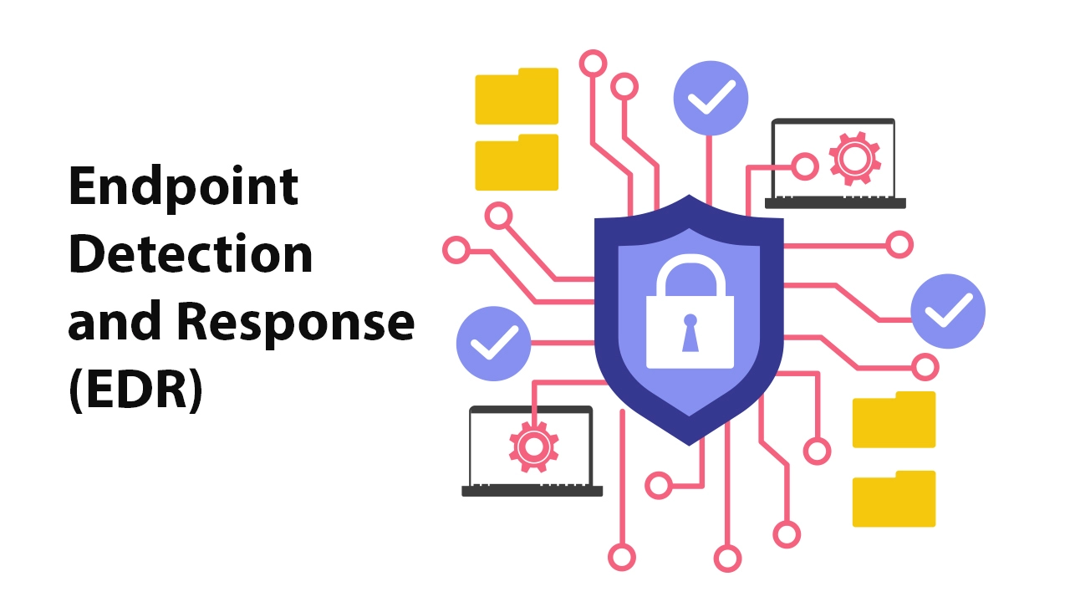
Endpoint Detection and Response Systems
Notes:
Explain that Endpoint Detection and Response (EDR) systems are designed to detect, investigate, and respond to threats at the endpoint level.
Core Functions: Continuous monitoring, threat detection, automated response, and forensic analysis capabilities.
Image Source: https://63sats.com/blog/edr-in-cyber-security/

Slide 49
Capabilities of EDR Systems
Real-time Monitoring and Alerting - tracks and monitors endpoint activities to detect malicious actions as they occur.
Behavioral Analytics - uses machine learning to identify deviations from normal behavior patterns that may indicate a threat.
Automated Response - can automatically contain and remediate threats at the endpoint level to prevent spread.
Notes:
Real-time Monitoring and Alerting - tracks and monitors endpoint activities to detect malicious actions as they occur.
Behavioral Analytics - uses machine learning to identify deviations from normal behavior patterns that may indicate a threat.
Automated Response - can automatically contain and remediate threats at the endpoint level to prevent spread.
Image Source: none

Slide 50
Benefits of EDR in ICS
Enhanced Visibility - Provides deep insights into endpoint activities, crucial for securing diverse and complex ICS networks.
Reduced Attack Surface - Helps to minimize the attack surface by quickly identifying and isolating compromised endpoints.
Compliance and Reporting - Facilitates compliance with regulatory requirements through comprehensive logging and reporting features.
Notes:
Enhanced Visibility - Provides deep insights into endpoint activities, crucial for securing diverse and complex ICS networks.
Reduced Attack Surface - Helps to minimize the attack surface by quickly identifying and isolating compromised endpoints.
Compliance and Reporting - Facilitates compliance with regulatory requirements through comprehensive logging and reporting features.
Image Source: none

Slide 51
Leveraging EDR for Threat Hunting
Integration with Other Security Tools
Continuous Monitoring and Real-time Analysis
Behavioral Analytics
Automated Response and Remediation
Advanced Threat Hunting Capabilities
Forensic Capabilities for Incident Investigation
Regular Updates and Training
Compliance and Regulatory Considerations
Notes:
Integration with Other Security Tools
Integrate EDR systems with other security tools such as SIEM, network traffic analysis tools, and threat intelligence platforms. This integration allows for a more comprehensive approach to security, enabling the correlation of data across different sources and a better understanding of the threat landscape.
Implementation: Ensure EDR solutions can seamlessly exchange data with these tools to create a unified security posture. Use APIs and standardized data formats to facilitate interoperability.
Continuous Monitoring and Real-time Analysis
Utilize the continuous monitoring and real-time analysis capabilities of EDR systems to detect anomalies and potential threats as they occur. This is crucial in ICS environments where even minor disruptions can lead to significant operational impacts.
Implementation: Configure EDR systems to monitor critical endpoints continuously, and set up real-time alerts for suspicious activities. Adjust sensitivity settings to balance between alert fatigue and missing critical alerts.
Behavioral Analytics
Leverage the behavioral analytics features of EDR systems to establish normal behavior patterns for endpoints and detect deviations that could indicate malicious activities.
Implementation: Use machine learning and heuristic-based analytics to develop baseline behaviors for each endpoint. Regularly update the behavior models to accommodate legitimate changes in endpoint usage.
Automated Response and Remediation
Use the automated response capabilities of EDR tools to quickly contain threats and mitigate damage. Automated responses can be crucial in preventing the spread of malware or stopping data breaches in their tracks.
Implementation: Set up predefined response actions for common threats, such as isolating infected endpoints from the network or terminating malicious processes. Ensure that automated actions are carefully calibrated to avoid unintended disruptions.
Advanced Threat Hunting Capabilities
Utilize the advanced threat hunting features provided by EDR systems to proactively search for hidden threats that have evaded other layers of defense.
Implementation: Regularly conduct manual and automated threat hunting sessions using the data collected by the EDR. Look for unusual patterns of behavior or anomalies that could indicate sophisticated attacks.
Forensic Capabilities for Incident Investigation
Take advantage of the forensic tools included in many EDR systems to perform detailed investigations following security incidents. These tools can help uncover the scope of an attack, the methods used by attackers, and potential data exposure.
Implementation: Use the EDR's forensic tools to collect and analyze data from affected endpoints. This should include retrieving logs, examining file changes, and tracking network connections made by the malware.
Regular Updates and Training
Keep the EDR system updated with the latest threat detection capabilities and ensure that security teams are trained to use the system effectively.
Implementation: Schedule regular updates and patches for your EDR system to protect against the latest threats. Provide ongoing training for security staff to ensure they are familiar with the latest features and best practices in threat hunting.
Compliance and Regulatory Considerations
Ensure that the use of EDR tools aligns with regulatory requirements specific to your industry, particularly those protecting critical infrastructure.
Implementation: Review compliance guidelines and ensure that EDR deployment adheres to industry-specific regulations, such as NERC CIP for the energy sector or GDPR for data privacy
Image Source: none

Slide 52

YARA
Notes:
YARA is a powerful tool widely used in cybersecurity, particularly for threat hunting and malware analysis. It can help create a more proactive defense strategy by allowing you to identify and classify malware samples based on textual or binary patterns.
Image Source: https://ai-techpark.com/importance-of-network-traffic-analysis/

Slide 53
Core Features of YARA
Pattern Matching - Ability to write descriptive rules based on textual or binary patterns found in files.
Flexibility - YARA can be used across various platforms and integrates with other forensic tools.
Scalability - Suitable for analyzing large sets of data efficiently and effectively.
Notes:
Pattern Matching - Ability to write descriptive rules based on textual or binary patterns found in files.
Flexibility - YARA can be used across various platforms and integrates with other forensic tools.
Scalability - Suitable for analyzing large sets of data efficiently and effectively.
Image Source: none

Slide 54
Basic Syntax of YARA rules
rule RuleName
{
strings:
$s1=“text here”
condition:
$s1
}
Text Strings
Hex Strings
RegEx Strings
yara64.exe <yara rule file> <filename> OR
yara64.exe <yara rule file> -r <directory>
Notes:
Example of a basic YARA rule, highlighting components like rule name, tags, strings, and condition.

Slide 55
Text String Example
find_string.yar
rule String_Found
{
strings:
$s1=“Maryland”
condition:
$s1
}
yara64.exe find_string.yar –r files OR
yara64.exe find_string.yar –r files –s (shows matched strings)
Notes:
Followed by Instructor Demo (command-line)

Slide 56
Text String (case-insensitive)
find_string.yar
rule String_Found
{
strings:
$s1=“maryland” nocase
condition:
$s1
}
case insensitive
yara64.exe find_string.yar –r files OR
yara64.exe find_string.yar –r files –s (shows matched strings)
Notes:
Followed by Instructor Demo (command-line)

Slide 57
Hex String
find_hex.yar
rule HEX_String_Found
{
strings:
$s1={2C 3A EB 48 CA AF 22 BC}
condition:
$s1
}
yara64.exe find_hex.yar –r files OR
yara64.exe find_hex.yar –r files –s (shows matched strings)
Notes:
Followed by Instructor Demo (command-line)

Slide 58
Text String: IP Address
find_ip.yar
rule Suspicious_IP_Found
{
strings:
$s1=“10.2.19.68”
condition:
$s1
}
yara64.exe find_ip.yar –r files OR
yara64.exe find_ip.yar –r files –s (shows matched strings)
Notes:
Followed by Instructor Demo (command-line)

Slide 59
Text String: Filenames
find_evil.yar
rule evil_php_Found
{
strings:
$s1=“evil.php”
condition:
$s1
}
yara64.exe find_evil.yar –r files OR
yara64.exe find_evil.yar –r files –s (shows matched strings)
Notes:
Followed by Instructor Demo (command-line)

Slide 60
Text String: Multiple Strings
find_strings.yar
rule Strings_Found
{
strings:
$s1=“Maryland”
$s2=“Montgomery”
$s3=“Austin”
condition:
$s1 and
$s2 and
$s3
}
yara64.exe find_strings.yar –r files OR
yara64.exe find_strings.yar –r files –s (shows matched strings)
Notes:
Followed by Instructor Demo (command-line)

Slide 61
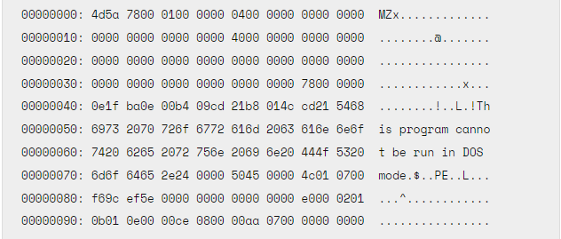
YARA PE Module
timestamp number_of_sections imports entry_point
and more….
Notes:
Followed by Instructor Demo (command-line)
https://yara.readthedocs.io/en/stable/modules/pe.html#

Slide 62
PE Imports Example
find_pe_imports.yar
import “pe”
rule interesting_pe_found
{
condition:
pe.number_of_sections == 6 and
pe.imports(“wininet.dll”)
}
yara64.exe find_pe_imports.yar –r files OR
yara64.exe find_pe_imports.yar –r files –s (shows matched strings)
Notes:
Followed by Instructor Demo (command-line)

Slide 63
Multiple Rules in One
find_multiple_rules.yar
yara64.exe find_multiple_rules.yar –r files OR
yara64.exe find_multiple_rules.yar –r files –s (shows matched strings)
Notes:
Followed by Instructor Demo (command-line)

Slide 64
Implementing YARA in Threat Hunting
Integration Strategies - integrate YARA with other tools like SIEM systems and EDR systems for enhanced detection capabilities.
Automated Scanning - set up automated scans with YARA to continuously monitor for threats
Response Actions - findings from YARA can trigger automated or manual response actions.
Notes:
Integration Strategies - integrate YARA with other tools like SIEM systems and endpoint protection for enhanced detection capabilities.
Automated Scanning - set up automated scans with YARA to continuously monitor for threats
Response Actions - findings from YARA can trigger automated or manual response actions.
Image Source: none

Slide 65
Challenges and Limitations
Rule Management – consider managing and updating YARA rules as new threats emerge.
Avoid False Positives/Negatives - fine-tune rules to minimize incorrect detections.
Performance Considerations - ensure that YARA scanning does not impact system performance adversely.
Notes:
Rule Management – consider managing and updating YARA rules as new threats emerge.
Avoid False Positives/Negatives - fine-tune rules to minimize incorrect detections.
Performance Considerations - ensure that YARA scanning does not impact system performance adversely.
Image Source: none

Slide 66

STIX/TAXII
Notes:
STIX (Structured Threat Information eXpression) and TAXII (Trusted Automated eXchange of Indicator Information) are standards used for sharing cyber threat intelligence.
Image Source: https://www.linkedin.com/pulse/stix-taxii-what-you-need-know-syed-mubeen/

Slide 67
Understanding STIX and TAXII
Structured Threat Information eXpression (STIX) – language for structuring cyber threat information
Structured Language
Rich Content
Trusted Automated eXchange of Intelligence Information (TAXII) - protocol used to transport cyber threat information securely
Communication Protocol
Supports Multiple Use Cases
Notes:
STIX - Mention that STIX is designed to convey the full range of potential cyber threat information, from high-level attacker tactics to specific indicators of compromise.
Structured Language: STIX allows for the standardized expression of cyber threat intelligence in a consistent manner.
Rich Content: It can describe detailed aspects of cyber threats, including behaviors, tactics, and communications among threat actors.
TAXII - Explain TAXII as the protocol used to transport cyber threat information securely. Highlight that TAXII defines services and message exchanges that enable sharing of information expressed in STIX.
Communication Protocol: TAXII is not about the threat information itself but about how it is communicated—securely and effectively.
Supports Multiple Use Cases: TAXII supports various use cases for threat intelligence sharing, including push/pull messaging, feed subscriptions, and more.
Image Source:none

Slide 68
Core Components of STIX
STIX Domain Objects (SDOs)
Indicators
Campaigns
Threat Actors
Attack Patterns
Malware
Relationships Among SDOs
Extensibility and Customization
Notes:
STIX Domain Objects: discuss how SDOs are the building blocks of STIX – and represent different types of cyber threat intelligence
Indicators: Observable data like IP addresses, URLs, or file hashes that suggest malicious activity.
Campaigns: Grouping of malicious activities that describe a set of attacks by threat actors to achieve a specific objective.
Threat Actors: Details about the individuals, groups, or organizations believed to be responsible for malicious activities.
Attack Patterns: Commonly used tactics, techniques, and procedures (TTPs) by threat actors.
Relationships Among SDOs: Discuss how STIX allows linking of different SDOs to depict complex relationships and narratives around cyber threats. This linking provides a comprehensive view of the threat landscape
Extensibility and Customization: Highlight the flexibility of STIX to accommodate additional information through custom objects and properties, allowing organizations to tailor the framework to their specific needs.
Image Source: none

Slide 69
Example: Indicator of Compromise (IoC)
STIX Object: Indicator
Type: Indicator
Spec Version: 2.1
ID: indicator--b1234c56-7890-1234-5678-9abc123e456f
Created: 2024-10-01T12:30:00.000Z
Modified: 2024-10-01T12:30:00.000Z
Name: Malicious Domain
Description: Indicator for a domain known to host phishing sites.
Pattern: [url:value = 'http://malicious-example.com']
Pattern Type: stix
Valid From: 2024-10-01T12:00:00.000Z
Labels: ["malicious-activity"]
Notes:
This example represents a STIX Indicator object that describes a malicious URL. It includes a unique identifier, timestamps for creation and modification, and a description of what the indicator represents. The pattern field specifies the actual observable data, in this case, a URL known to be malicious.
Image Source: none

Slide 70
Example: Threat Actor
STIX Object: Threat Actor
Type: Threat Actor
Spec Version: 2.1
ID: threat-actor--c3457d68-1234-5678-9123-6abcdef23456
Created: 2024-09-15T09:00:00.000Z
Modified: 2024-09-15T09:30:00.000Z
Name: "Fancy Bear"
Description: A sophisticated cyber espionage group believed to be sponsored by a national government.
Aliases: ["APT28", "Sofacy"]
Goals: ["Espionage", "Data theft"]
Sophistication: "High"
Resource Level: "Government"
Notes:
This STIX object represents a Threat Actor, providing key details about the actor, such as their name, known aliases, goals, level of sophistication, and the resources they have at their disposal. It helps cybersecurity professionals understand the capabilities and intentions of the actor.
Image Source: none

Slide 71
Example: Attack Pattern
{
"type": "attack-pattern",
"spec_version": "2.1",
"id": "attack-pattern--01234567-89ab-cdef-0123-456789abcdef",
"created": "2021-10-01T00:00:00.000Z",
"modified": "2021-10-01T00:00:00.000Z",
"name": "Spear Phishing Attachment",
"description": "Adversaries may send spearphishing emails with a malicious attachment in an attempt to gain access to victim systems. Once opened, the attachment can be leveraged to execute malicious code.",
"external_references": [
{
"source_name": "mitre-attack",
"external_id": "T1566.001",
"url": "https://attack.mitre.org/techniques/T1566/001/",
"description": "MITRE ATT&CK Technique: Spear Phishing Attachment (T1566.001)"
}
Notes:
This Attack Pattern object describes a common cyber attack technique (Spear Phishing). It includes an external reference to the MITRE ATT&CK Technique for Spear Phishing Attachments: T1566.001
Image Source: none

Slide 72

STIX in ICS Environments
Integration with Existing Security Systems
Customization for ICS-Specific Threats
Sharing Threat Intelligence
Proactive Threat Hunting
Incident Response and Forensics
Compliance and reporting
Notes:
Integration with Existing Security Systems
STIX data can be integrated into various security systems used in ICS, such as Security Information and Event Management (SIEM) systems, Intrusion Detection Systems (IDS), and other threat detection tools.
Implementation: STIX data, once received via TAXII feeds or other sources, can be processed by these systems to match indicators of compromise (IoCs) against observed network and endpoint behaviors. This integration allows for automated alerting and response based on the latest threat intelligence.
Customization for ICS-Specific Threats
STIX allows for the customization of threat intelligence to address specific threats that target ICS environments, such as malware that affects SCADA systems or targeted attacks against utility infrastructure.
Implementation: Security teams can develop or tailor STIX profiles that focus on the unique operational technologies and protocols used in ICS, such as Modbus, DNP3, or other industrial protocols. By monitoring for anomalies or malicious activities that exploit these protocols, teams can detect and mitigate potential threats more effectively.
Sharing Threat Intelligence
In ICS environments, sharing threat intelligence between different entities—such as plant operators, manufacturers, and national infrastructure protection agencies—can be crucial for collective defense.
Implementation: Organizations can use TAXII to automate the exchange of STIX-formatted threat data with trusted partners. This not only helps in getting timely intelligence but also aids in building a collaborative defense against threats that target multiple players within an industry.
Proactive Threat Hunting
Proactive threat hunting in ICS can be enhanced by using STIX to define and share information about emerging threats, attack patterns, and tactics used by adversaries.
Implementation: Threat hunters can use STIX to document their findings and share them within and across organizations. This shared knowledge enables other entities to quickly adapt their defensive measures according to real-world data about new or evolving threats.
Incident Response and Forensics
In the aftermath of a cybersecurity incident, STIX can be invaluable for incident response and forensic analysis, providing structured data that helps in understanding the attack vectors, impacted systems, and the nature of the attack.
Implementation: Utilize STIX objects to record details of the incident, including affected systems, the timeline of the attack, and the methods used by attackers. This record not only aids in forensic analysis but also serves as a historical log that can be used for future threat detection and prevention strategies.
Compliance and Reporting
Many ICS environments are subject to stringent regulatory requirements which mandate the reporting of security incidents and the sharing of threat intelligence.
Implementation: STIX can be used to standardize reports and ensure they meet compliance requirements. This structured reporting makes it easier to communicate with regulatory bodies and provides a clear audit trail of threat intelligence activities and incident response.
Image Source: https://cdn.prod.website-files.com/635e632477408d12d1811a64/64062c44d346544eb48fd0fb_Leveraging-STIX-and-TAXII-for-better-Cyber-Threat-Intelligence.png

Slide 73

Embedded Systems Security Tools
Notes:
We will discuss tools specifically designed for embedded security, their functionalities, best practices for implementation, and how they can be leveraged to enhance security in ICS environments
Image Source: Midjourney
“a highly detailed 16x9 cartoon of A graphic showing a network of embedded devices within an industrial setting. “

Slide 74

Embedded Systems Security in ICS
Role in ICS – these systems control, monitor, and directly influence physical processes in industry
Common Security Vulnerabilities
Insecure Firmware Updates
Lack of Authentication/Authorization
Physical Security Risks
Impact of Security Breaches
Operational Disruption
Safety Hazards
Notes:
Role in ICS Discuss how these systems control, monitor, and directly influence physical processes in industries like manufacturing, energy, and transportation. Note the widespread use and increasing connectivity of embedded systems, which raise significant security concerns.
Common Security Vulnerabilities - Discuss the typical security vulnerabilities found in embedded systems, including both hardware and software flaws.
Insecure Firmware Updates: The risk of installing malicious or flawed firmware updates that could compromise the system.
Lack of Authentication/Authorization: Weaknesses in verifying the identities or permissions of entities interacting with the system.
Physical Security Risks: Vulnerabilities that arise from inadequate physical security measures protecting the hardware from unauthorized access.
Impact of Security Breaches
Operational Disruption: Detail how attacks can lead to shutdowns or malfunctions in critical infrastructure systems.
Safety Hazards: Emphasize the potential for causing physical harm to workers or the public if safety-critical systems are compromised.
Image Source: MidJourney
“A diagram or image showing various embedded systems integrated within an industrial setup, such as PLCs, RTUs, and networked sensors.”

Slide 75
Security Tools for Embedded Systems
Firmware Analysis Tools
Static/Dynamic Analysis
Signature Verification
Hardware Security Modules (HSM)
Real-Time Operating System (RTOS) Security Enhancements
Memory Protection
Secure Boot
Access Controls
Notes:
Firmware Analysis Tools: Discuss the importance of tools that analyze and verify the integrity of firmware running on embedded devices. These tools help identify vulnerabilities, unauthorized changes, or signs of tampering in firmware.
Static Analysis: Analyzing firmware code without executing it to find vulnerabilities.
Dynamic Analysis: Monitoring firmware behavior during execution to detect potential security issues.
Signature Verification: Ensuring firmware authenticity and integrity through cryptographic signatures.
Hardware Security Modules (HSM): Explain how HSMs are used to manage digital keys for strong authentication and provide cryptographic processing in a physically secure environment, enhancing the security of embedded systems.
Real-Time Operating System (RTOS) Security Enhancements
Memory Protection: Mechanisms to prevent unauthorized access or corruption of memory, such as data execution prevention.
Secure Boot: Ensuring the system boots using only verified and trusted software to prevent malware from running at startup.
Access Controls: Implementing robust user authentication and authorization protocols within RTOS.
Image Source: none

Slide 76

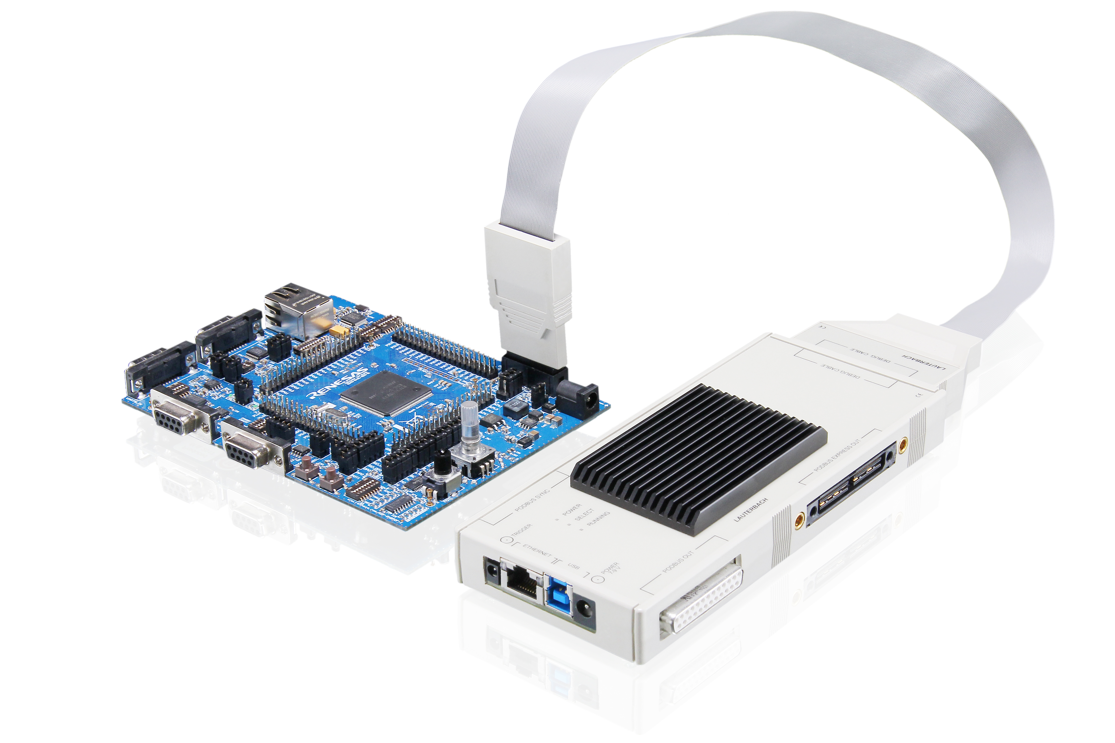
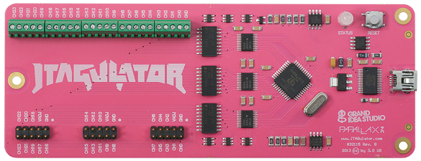
Specific Tool Examples
Binary Analysis Tool (BAT)
CHIPSEC
Lauterbach Debug Tools
JTAGulator
IDA Pro
Notes:
Each of these tools offers unique capabilities that are pertinent to enhancing security in embedded systems, particularly within critical infrastructures like ICS. Leveraging these tools effectively can significantly enhance an organization's ability to detect vulnerabilities early, manage security configurations, and respond to potential threats proactively.
Binary Analysis Tool (BAT)
Functionality: BAT is designed to analyze binary files for security auditing and malware scanning in embedded systems. It scans firmware images before they are deployed to hardware to ensure that they are free from known vulnerabilities and malware.
Application in ICS: In Industrial Control Systems (ICS), BAT can be used to scan device firmware for unauthorized modifications or potential backdoors before the firmware is uploaded to critical components, such as PLCs or RTUs.
Benefits: Helps prevent attacks that exploit firmware vulnerabilities, thereby ensuring the integrity and reliability of the embedded systems.
CHIPSEC
Functionality: CHIPSEC is a security assessment framework that tests the security of platform hardware and firmware. The toolset includes modules that check for vulnerabilities in firmware, including UEFI/BIOS and hardware security configuration, and capabilities to analyze system memory and hardware registers.
Application in ICS: This tool is crucial for ensuring that the foundational hardware security configurations in ICS components are robust and not vulnerable to exploits that could bypass higher-level security measures.
Benefits: By verifying that the hardware configuration and firmware follow best security practices, CHIPSEC helps protect embedded systems from sophisticated attacks that target hardware-level vulnerabilities.
Lauterbach Debug Tools
Functionality: Lauterbach tools provide comprehensive debugging solutions that support a wide range of chip architectures. These tools are used for development and debugging of firmware on embedded devices, with capabilities to perform system-level debugging, crash analysis, and system trace.
Application in ICS: Debug tools are essential for diagnosing hardware operation issues and vulnerabilities in real time, which is critical for maintaining operational uptime in ICS environments.
Benefits: Facilitates the identification and fixing of security flaws and functional bugs during the development phase of firmware, reducing the risk of vulnerabilities in deployed systems.
JTAGulator
Functionality: JTAGulator is an open-source hardware tool designed to identify on-chip debug interfaces (e.g., JTAG, UART) on unknown circuit boards. It assists in discovering such interfaces which can then be used to debug embedded devices and potentially identify security vulnerabilities.
Application in ICS: Useful for security penetration testing and reverse engineering of devices used in industrial settings where documentation may be lacking or the security state of a device is unknown.
Benefits: Helps in identifying hidden debug ports that could be exploited by attackers to gain low-level control over embedded systems.
IDA Pro
Functionality: IDA Pro is a disassembler and debugger tool that is widely used for reverse engineering. It supports a vast array of processor instructions sets and can be used to analyze binary programs in which source code is not available, such as proprietary embedded firmware.
Application in ICS: IDA Pro can be used to reverse engineer malware or firmware found in ICS environments to understand how it operates and to develop defenses against it.
Benefits: Critical for analyzing and understanding potential security threats embedded in the binary level, enabling proactive defense and incident response strategies.
Image Source:
Chipsec: https://github.com/chipsec
Lauterbach: https://www.lauterbach.com/products/debugger/powerdebug-system/powerdebug-x50
JTAGulator: https://wiki.elvis.science/index.php?title=JTAGulator:_Introduction

Slide 77
Case Study: Secure Firmware Deployment in Energy Sector
Background
A major energy provider, servicing millions of customers across a broad region, faced significant cybersecurity threats aimed at disrupting power distribution. Key vulnerabilities were identified in the firmware of their control systems, which were susceptible to unauthorized modifications and malware infections.
Challenge
The company needed to ensure the integrity and authenticity of the firmware running on thousands of embedded systems scattered across various remote sites, which were critical to grid management and power distribution operations.
Notes:
Background: A major energy provider, servicing millions of customers across a broad region, faced significant cybersecurity threats aimed at disrupting power distribution. Key vulnerabilities were identified in the firmware of their control systems, which were susceptible to unauthorized modifications and malware infections.
Challenge: The company needed to ensure the integrity and authenticity of the firmware running on thousands of embedded systems scattered across various remote sites, which were critical to grid management and power distribution operations.
Image Source: none

Slide 78
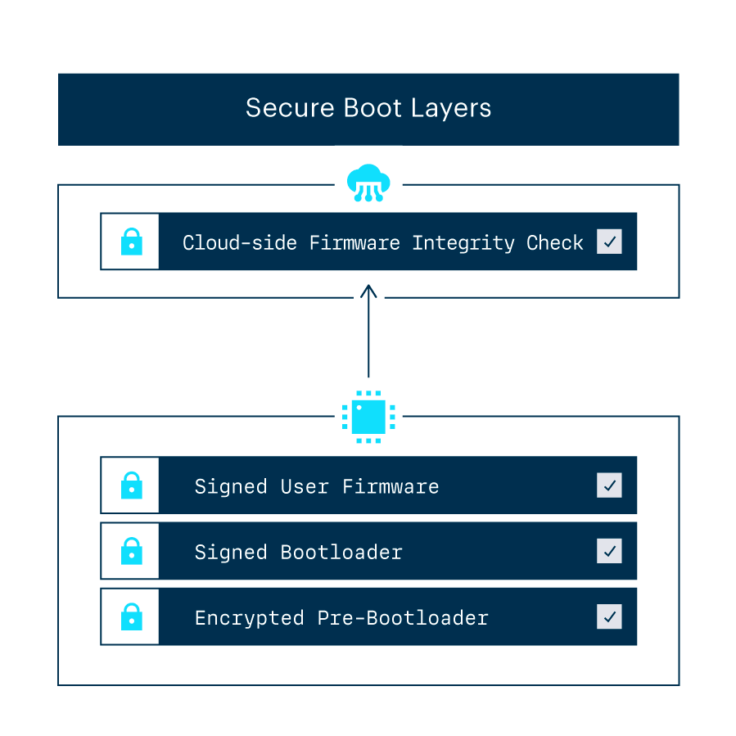
Solution: Secure Firmware Deployment in Energy Sector
Firmware Analysis Tools
Deployment
Functionality
Secure Boot Implementation
Setup
Layered Security
Automated Response Systems
Integration
Notification
Notes:
Solution:
The company implemented a comprehensive firmware security protocol using advanced firmware analysis tools and secure boot processes.
Firmware Analysis Tools:
Deployment: Integrated firmware analysis tools were deployed to routinely scan and verify the integrity of firmware on all embedded devices.
Functionality: These tools were programmed to detect unauthorized changes, potential backdoors, or signs of tampering by comparing current firmware states against verified baselines and cryptographic signatures.
Secure Boot Implementation:
Setup: The secure boot process was established to ensure that only signed firmware, verified against a trusted certificate authority, could be executed on the devices.
Layered Security: Multiple layers of security checks were incorporated during the boot process to detect and prevent the execution of compromised firmware.
Automated Response Systems:
Integration: Automated response mechanisms were set up to immediately isolate devices with compromised firmware, preventing potential cascading effects on the power grid.
Notification: System administrators were automatically alerted to any anomalies for rapid response and remediation.
Image Source: https://www.particle.io/iot-guides-and-resources/iot-secure-boot/

Slide 79

Secure Firmware Deployment in Energy Sector
OUTCOME
Reduced Incidents
Enhanced Security Posture
Regulatory Compliance
Notes:
This case study provides a comprehensive example of how an energy provider successfully enhanced the security of its embedded systems, providing a template and insights that could be applicable to other sectors within the ICS environment.
Outcome:
Reduced Incidents - The implementation of firmware analysis tools and secure boot processes significantly reduced the incidence of malware infections and unauthorized firmware updates across embedded systems.
Enhanced Security Posture: The proactive measures taken enhanced the overall security posture of the energy provider, ensuring the stability and reliability of power distribution services.
Regulatory Compliance: The new security implementations also aligned with national cybersecurity regulations for critical infrastructure, avoiding potential fines and penalties.
Image Source: MidJourney
“Display statistics showing the reduction in security incidents before and after implementation of a secure boot implementation”

Slide 80
Case Study: Advanced Encryption in Manufacturing Automation
Background
A large manufacturing company specializing in high-precision components faced challenges protecting proprietary designs and operational data communicated between devices on their manufacturing floor. The company was particularly concerned about industrial espionage and data breaches.
Challenge
The company's manufacturing processes relied heavily on automated systems that communicated sensitive information continuously. These systems were vulnerable to interception and unauthorized access due to inadequate encryption measures.
Notes:
Background
A large manufacturing company specializing in high-precision components faced challenges protecting proprietary designs and operational data communicated between devices on their manufacturing floor. The company was particularly concerned about industrial espionage and data breaches.
Challenge
The company's manufacturing processes relied heavily on automated systems that communicated sensitive information continuously. These systems were vulnerable to interception and unauthorized access due to inadequate encryption measures.
Image Source: none

Slide 81
Solution: Advanced Encryption in Manufacturing Automation
HSM Integration
Deployment
Functionality
Encryption Protocols
Implementation
Secure Data Storage
Regular Key Rotation & Management
Process Setup
Audit and Compliance
Notes:
Solution:
The company decided to integrate Hardware Security Modules (HSMs) to bolster their security framework, focusing on key management and data encryption
HSM Integration:
Deployment: HSMs were deployed within the company’s network infrastructure to handle all cryptographic operations, including key generation, encryption, decryption, and key storage.
Functionality: The HSMs provided a physically tamper-proof environment for managing digital keys, ensuring that sensitive operations related to key management were isolated from other network activities.
Encryption Protocols:
Implementation: All data transmissions between devices on the manufacturing floor were encrypted using strong encryption protocols managed by the HSMs. This ensured that data, such as machine operational parameters and product designs, was secure in transit.
Secure Data Storage: HSMs were also used to encrypt sensitive data at rest, providing an additional layer of security for stored data.
Regular Key Rotation and Management:
Process Setup: Automated key rotation policies were implemented to ensure that encryption keys were changed periodically, reducing the risk of key compromise.
Audit and Compliance: The HSMs facilitated detailed logging of all key management activities, supporting compliance with industry security standards and audits.
Image Source: none

Slide 82

Advanced Encryption in Manufacturing Automation
OUTCOME
Enhanced Data Security
Regulatory Compliance
Operational Efficiency
Notes:
This case study showcases a practical application of advanced encryption technologies in a manufacturing setting, providing valuable insights into how similar strategies can be deployed in other sectors to protect sensitive data and maintain compliance with security standards.
Outcome:
Enhanced Data Security: The integration of HSMs significantly strengthened the encryption of data transmissions and storage, mitigating the risk of industrial espionage.
Regulatory Compliance: With robust encryption practices managed through HSMs, the company met stringent compliance requirements for data protection.
Operational Efficiency: By automating key management and encryption processes, the company maintained high operational efficiency without compromising security.
Image Source: MidJourney
A diagram showing the encryption workflow managed by HSMs, including key generation, encryption/decryption processes, and key rotation

Slide 83
Threat Hunting Exercises

Slide 84
Module 07 – ICS Threat Hunting
Lab and CISA Certs
Lab 7 – Case Analysis Handout with MITRE
Link and Handout Provided By Instructor
CISA ICS Cert (210W-06 & 210W-07)
https://www.cisa.gov/resources-tools/programs/ics-training-available-through-cisa
Course Title
CRN
©2021 CyberSkills2Work - Institution Name
Notes:
Instructor Notes:
Please complete Lab 6 before next week’s Module. A link to The Risk Assessment report and instructions will be provided to students.

